Slide 1

Machine Learning for Cyber Security
Week 10
Mesut GUVEN, Ph.D.

Slide 2
information
Exams; 55% (Mid 25% + Final 30%), Homeworks; 15%, Project; 30%
In homeworks, you will be expected to examine SCI/E papers (published in last 3 years).
In Final Project, you will implement an AI/ML-based cyber solution.
Textbook:
- Getting Started with Deep Learning: Programming and Methodologies using Python
- Hands-On Machine Learning with Scikit-Learn, Keras, and TensorFlow, 2nd Edition
Code: GitHub
Videos: YouTube

Slide 3
UNIT 10: word tokenization for Dl
Learning Outcomes;
- have a better understanding of word tokenization,
- have a better understanding of using word tokenization for assembly code analyze.

Slide 4
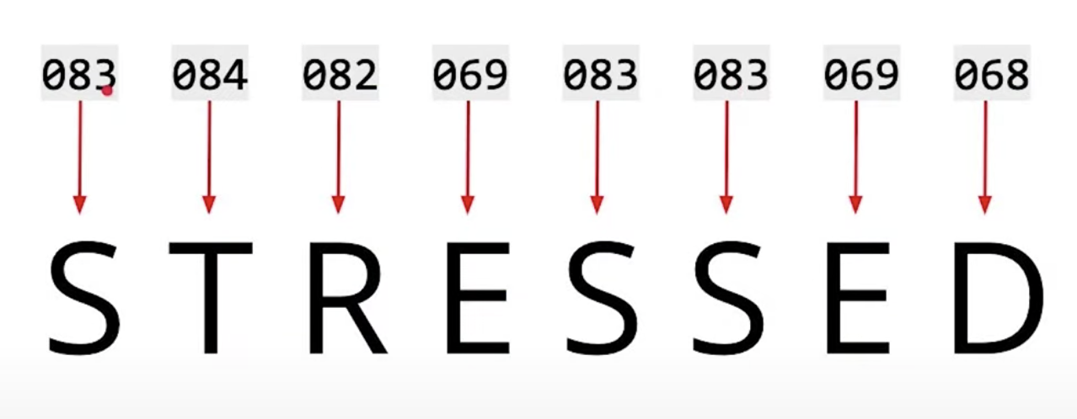
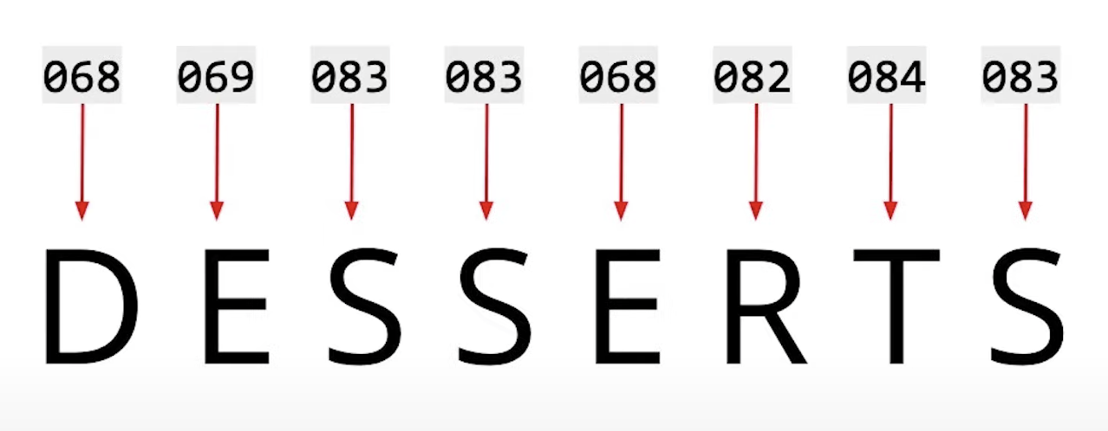
Word tokenization
Neural networks accepts numbers as inputs.
If we expect the DL models to process words and the text meaning, we need to convert inputs (letters/words) into numbers. This process is called tokenization.
One way to convert words to numbers is to assign each letter to a number.
But this is not enough, we also need the sequence of occurrence of the letters or words in the text.
We can also tokenize the WORDS rather than letters.

Slide 5
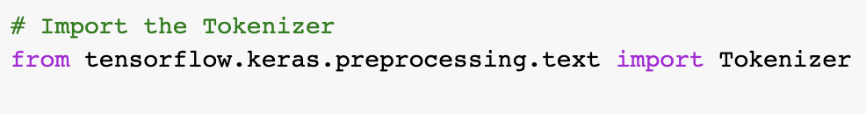
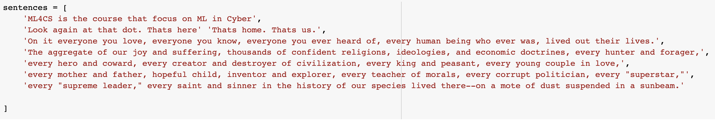
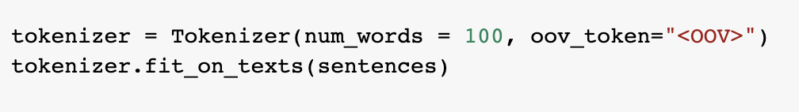
Word tokenization
First, Keras Tokenizer property is called.
Then, a dictionary is created
Using Tokenizer, the words in the dictionary (sentence) are converted to numbers. <OOV> means Out of Vocabulary and assigns a fix value (1) for all unknown words.

Slide 6
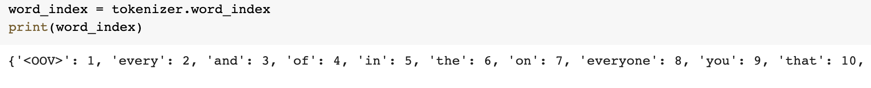
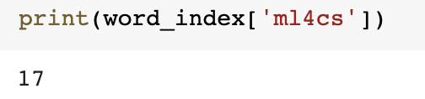
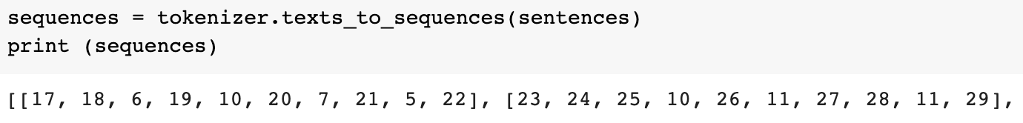
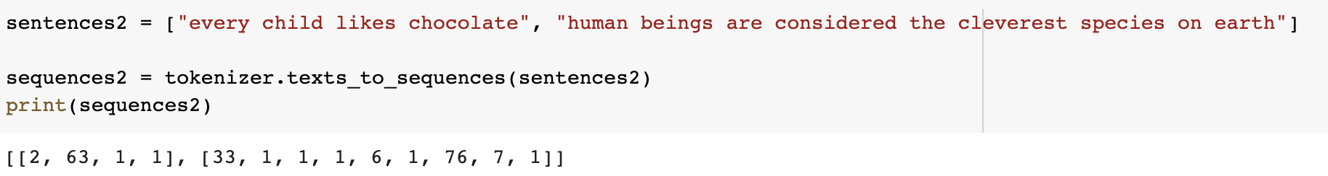
Word tokenization
After you tokenize the text, the tokenizer has a word index that contains key-value pairs for all the words and their numbers.
The word is the key, and the number is the value
Words in a sentence have an order. So, after tokenizing the words, the next step is to generate sequences for the sentences.
If the sentence being sequenced contains words that are not in the word index, The Out of Vocabulary (OOV) value is assigned.

Slide 7
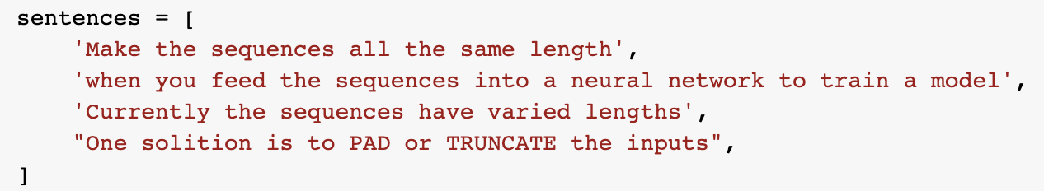
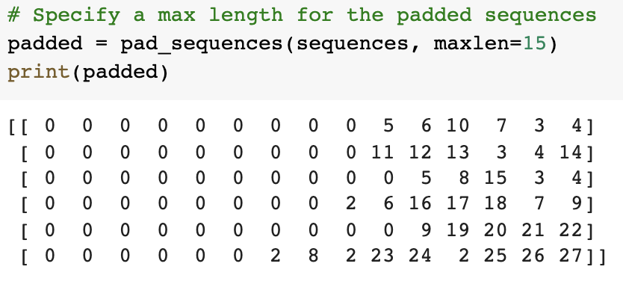
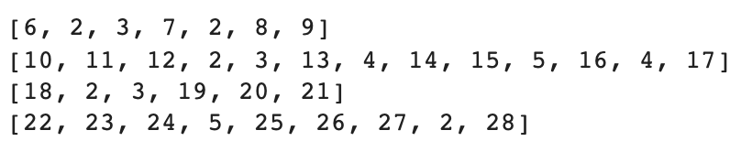
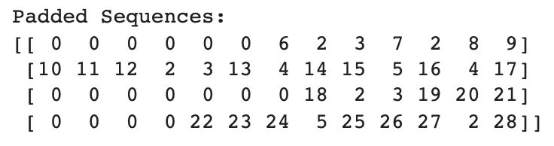
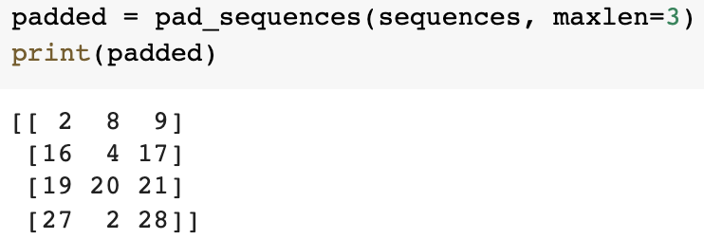
Making inputs to have the same length

Slide 8
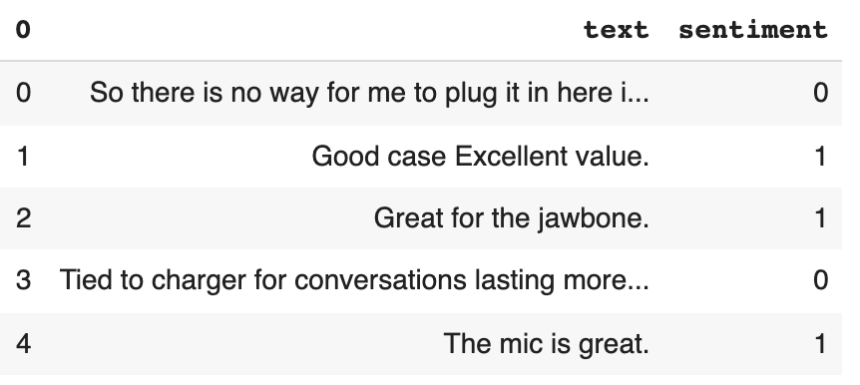
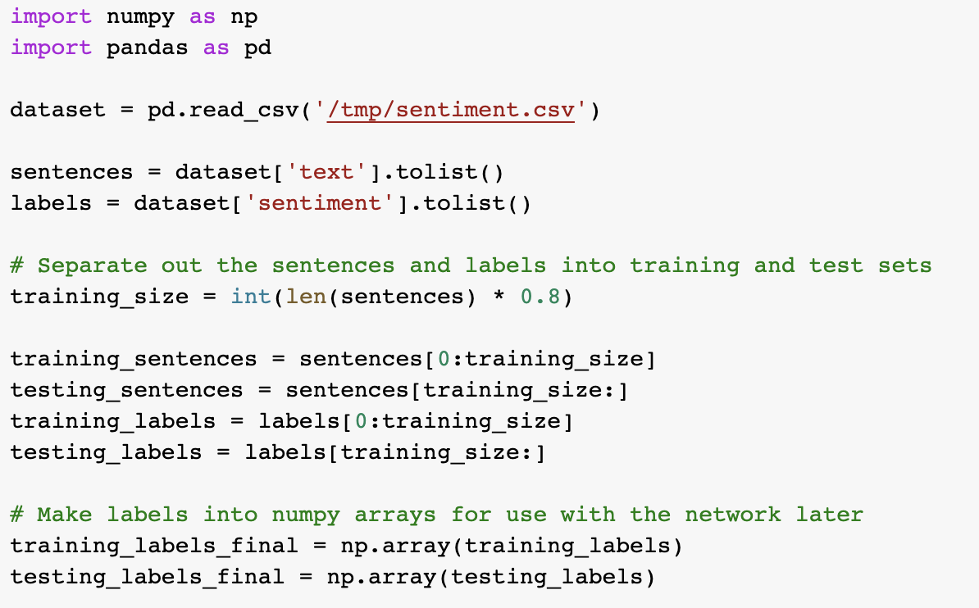
Sentiment analysis example with review dataset
Review data set has 2000 comments with a label either positive (1) or negative (0) sentiment.
The same way as we did before, using pandas, read the file and assign text part for features and sentiments for the class labels.
Secondly, divide the data into 80% for training and rest for the testing.

Slide 9
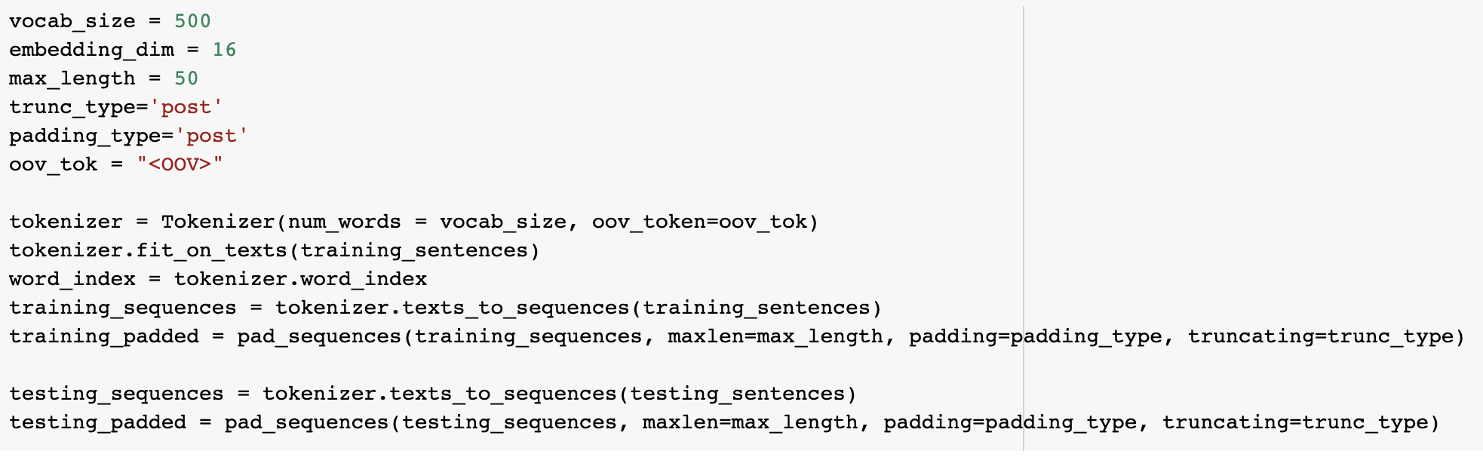
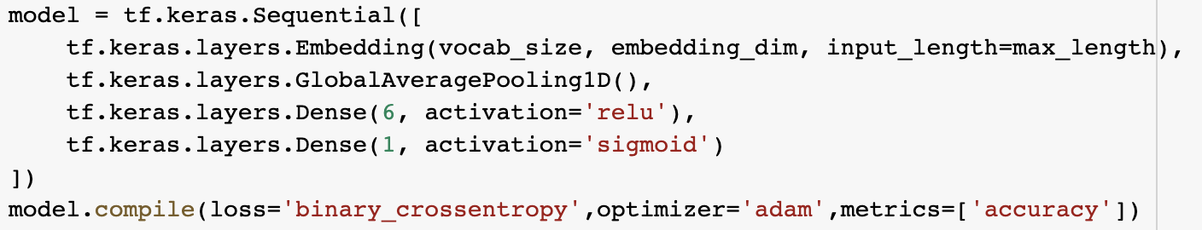
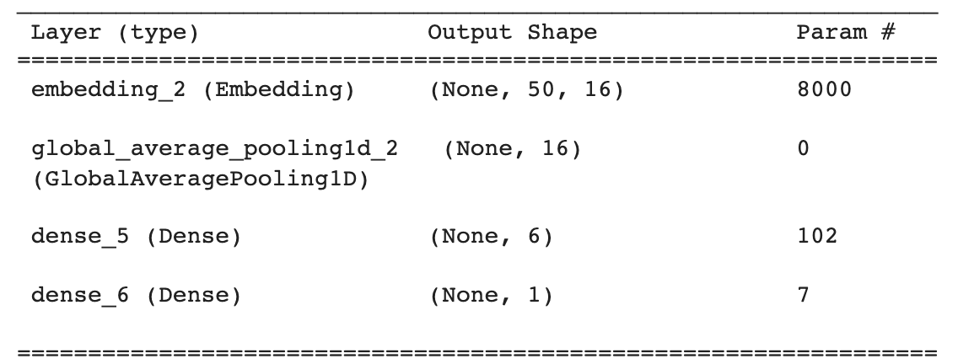
Sentiment analysis example with review dataset
Take most common 500 words for dictionary and tokenize it.
Pad or truncate all the comments (inputs) to 50 words.
Embeddings are clusters of vectors in multi-dimensional space, where each vector represents a given word in those dimensions.
GlobalAvaragePooling is used for Flattening.

Slide 10
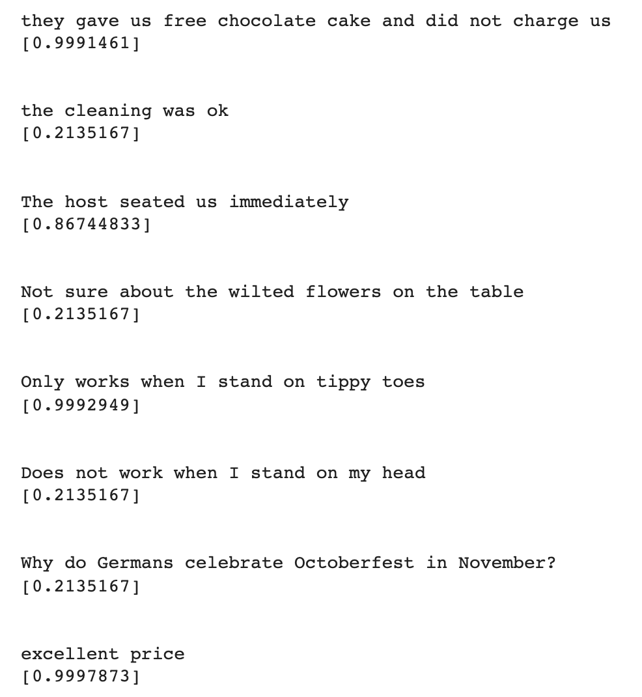
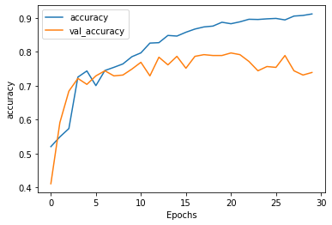
Sentiment analysis example with review dataset
After 30 epochs the model reached ~75% acc.
The results are seen for the genuine comments. The closer the class is to 1, the more positive the review is deemed to be.

Slide 11
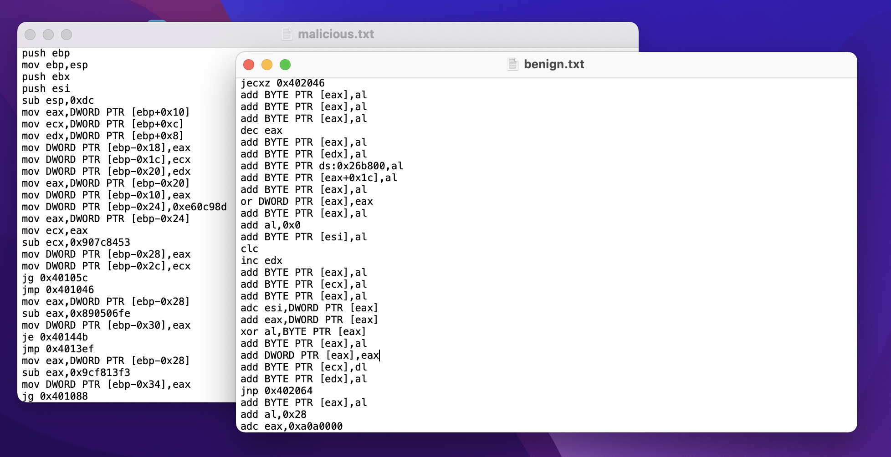
malware analysis with assembly and tokenization [1]
It is possible to use assembly codes as text inputs for the DL models.
DATASET: Consisted of benign and malicious executables in Portable Executable format. Generated native Win32 PE files from Windows operating systems2.

Slide 12
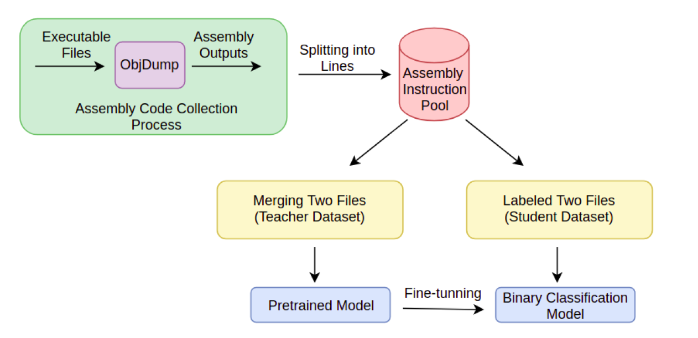
malware analysis with assembly and tokenization [1]
“from tokenizers import ByteLevelBPETokenizer” is used for tokenization.
“from transformers import LineByLineTextDataset” splits data into chunks,
“from transformers import DataCollatorForLanguageModeling” pad inputs to same size.
“from sklearn.metrics import accuracy_score, classification_report” used for displaying metrics.
“from Transformers Import GPT2ForSequenceClassification” is a transformer-based model for a sequence classification using the last token to do the classification.

